Slide 1
Phonepe Transaction Insights

Slide 2
Project Overview
With the rapid growth of digital payment platforms like phonepe, it is essential to understand how users interact with these services. This project focuses on analyzing and visualizing transaction data, user engagement patterns, and insurance-related metrics. Key objectives include:
Analyzing aggregated values across payment categories
Mapping total transactions and values at state and district levels
Identifying top-performing states, districts, and pin codes
These insights help uncover trends, highlight growth areas, and support data-driven strategies to enhance service delivery and user targeting.

Slide 3
BUSINESS CASE STUDY
Decoding transaction dynamics on phonepe
User engagement and growth strategy
Transaction analysis across states and districts
User registration analysis
Insurance transaction analysis

Slide 4
Decoding transaction dynamics on phonepe

Slide 5
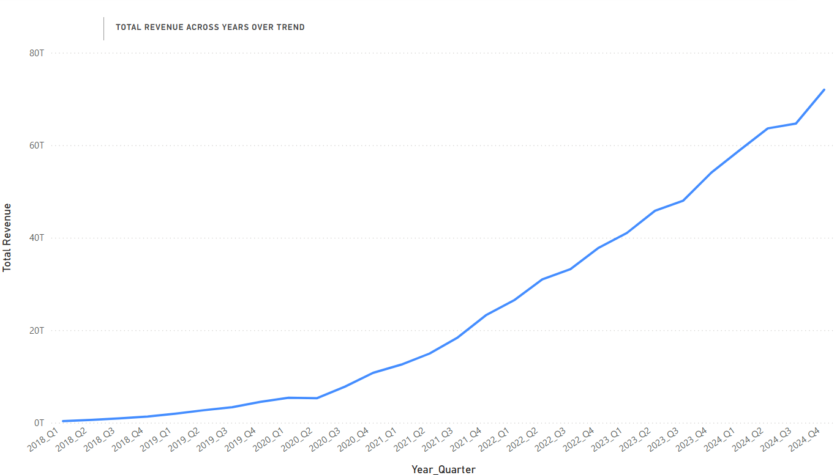
Transaction Revenue Growth Over Time
Key Findings
Steady and significant growth from 2018 to 2024
Revenue crossed ₹80 trillion by end of 2024
Rapid acceleration post-2020, especially after Q2 2021
Indicates increasing digital adoption across India
Recommendations
Promote use of Phonepe for bill payments, recharges, and insurance by offering cashback or reward points.
Educate users on time-saving benefits and security.

Slide 6
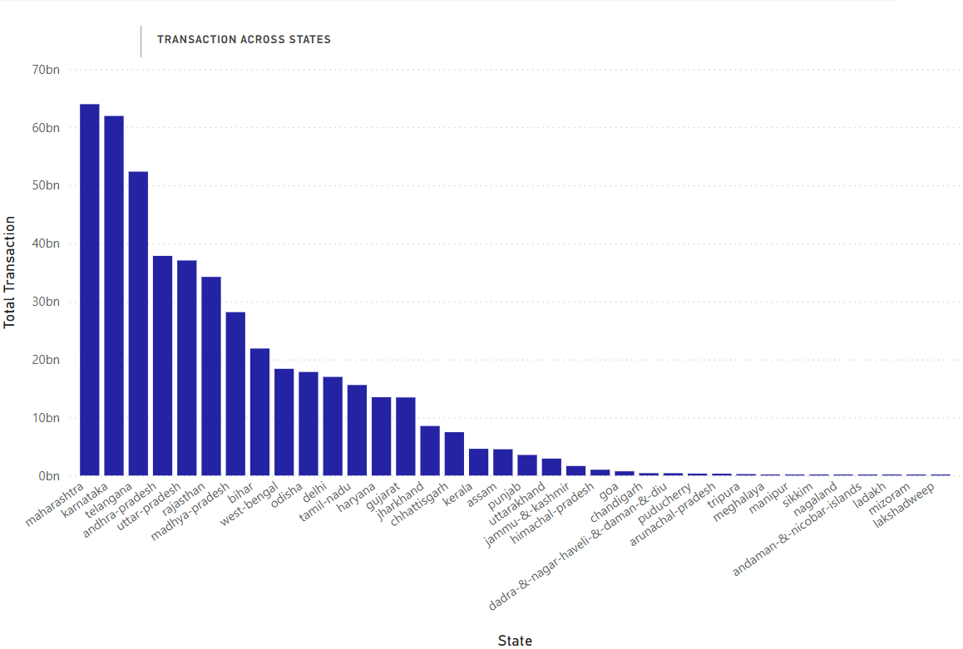
Total Transaction by States
Key Findings
Maharashtra, Karnataka, and Telangana lead in digital transactions
Higher adoption in southern and western states
Low transaction volumes in northeastern and union territories
Highlights regional disparity in digital payment usage
Recommendations
Launch awareness campaigns and incentive programs in low-volume states (e.g., NE states, UTs).
Improve digital infrastructure and merchant onboarding in these areas.

Slide 7
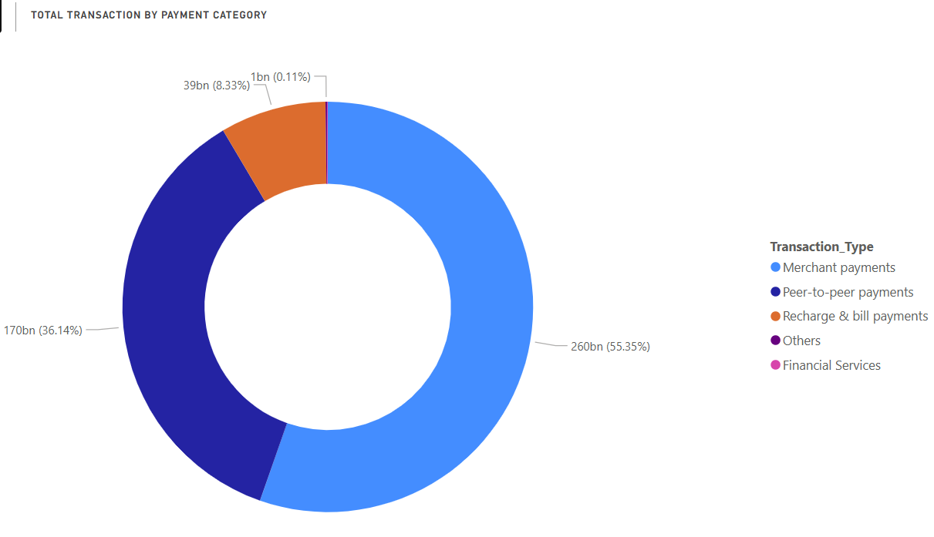
Transaction Breakdown by Payment Category
Key Findings
Merchant payments dominate with 55.35% share (₹260 bn)
peer-to-peer payments are 2nd with 36.14% (₹170 bn)
Recharge, bills, financial services form a small portion
Indicates shift toward digital commerce and retail usage
Recommendations
Expand POS services and UPI QR accessibility in semi-urban/rural markets.
Offer business analytics or loyalty programs for small vendors.
Convert peer-to-peer users into service users (e.g., mutual funds, gold purchase, loan offers).

Slide 8
User engagement and growth strategy

Slide 9
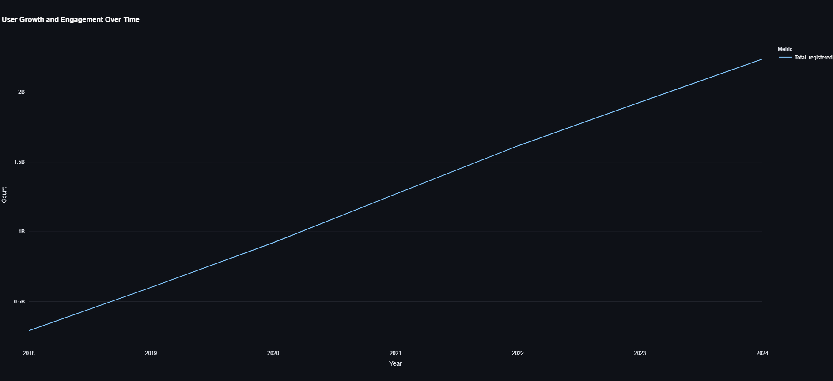
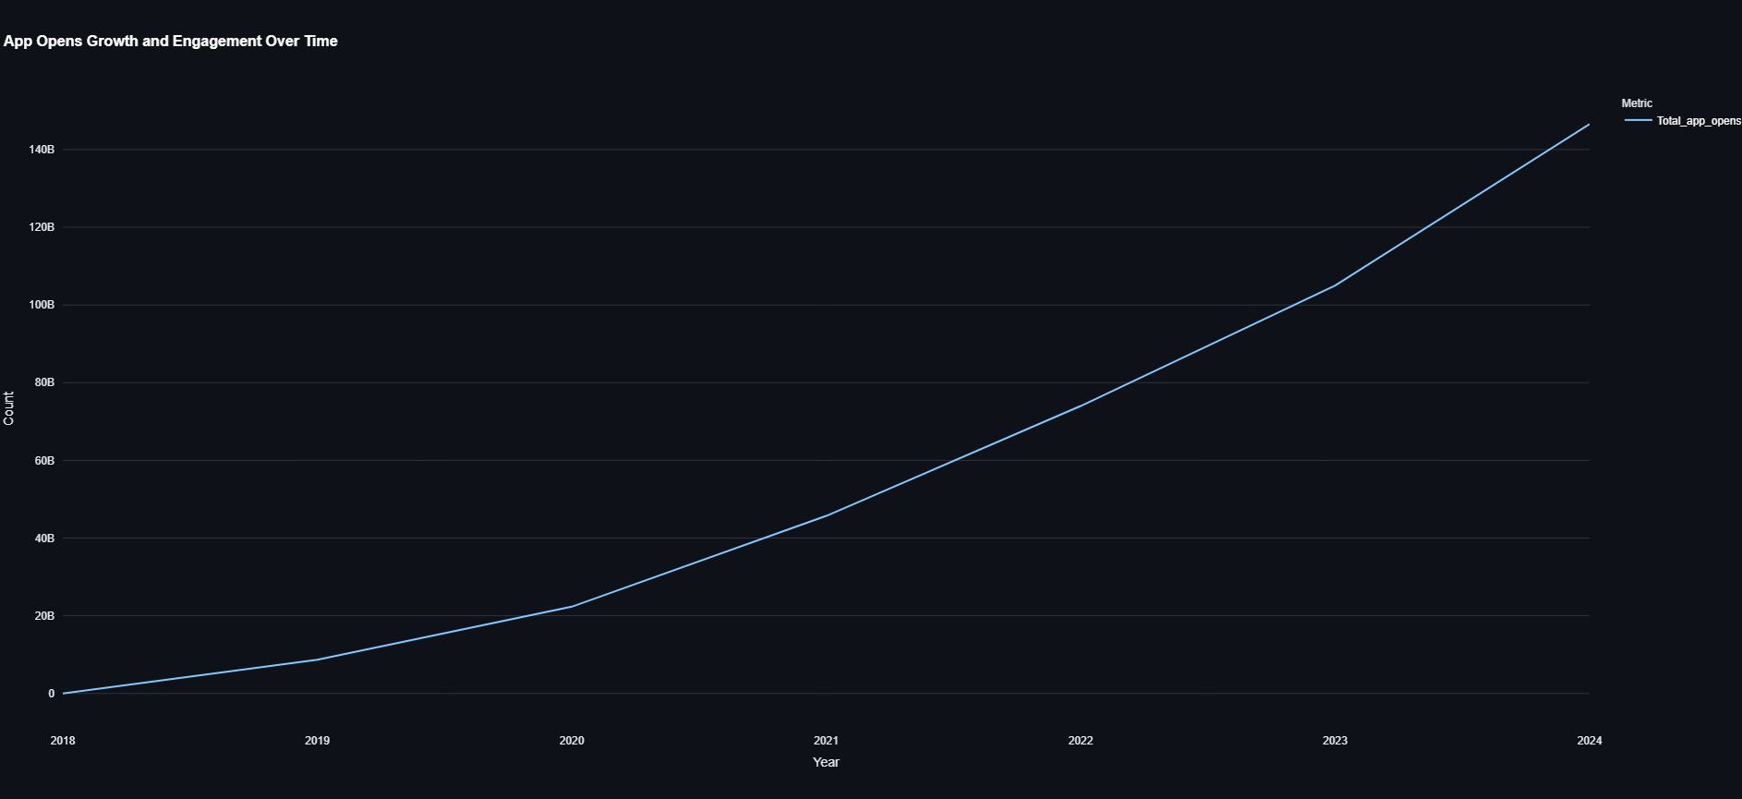
User Growth and Engagement Over Time
Key Findings
Total registered users have grown steadily from 2018 to 2024, crossing 2 billion — showing continuous platform expansion.
App opens have increased rapidly over the years, reaching over 140 billion by 2024, indicating active and repeated usage.
Significant boost in both metrics after 2020 suggests pandemic-driven digital adoption and increased reliance on digital financial tools.
Recommendations
Reward frequent app openers with tiered loyalty points or personalized offers to retain engagement.
As user base and opens grow, optimize performance, speed, and UX to ensure smooth scalability and satisfaction.
Use app engagement data to promote additional services like insurance, mutual funds, or gold purchases through in-app notifications.

Slide 10
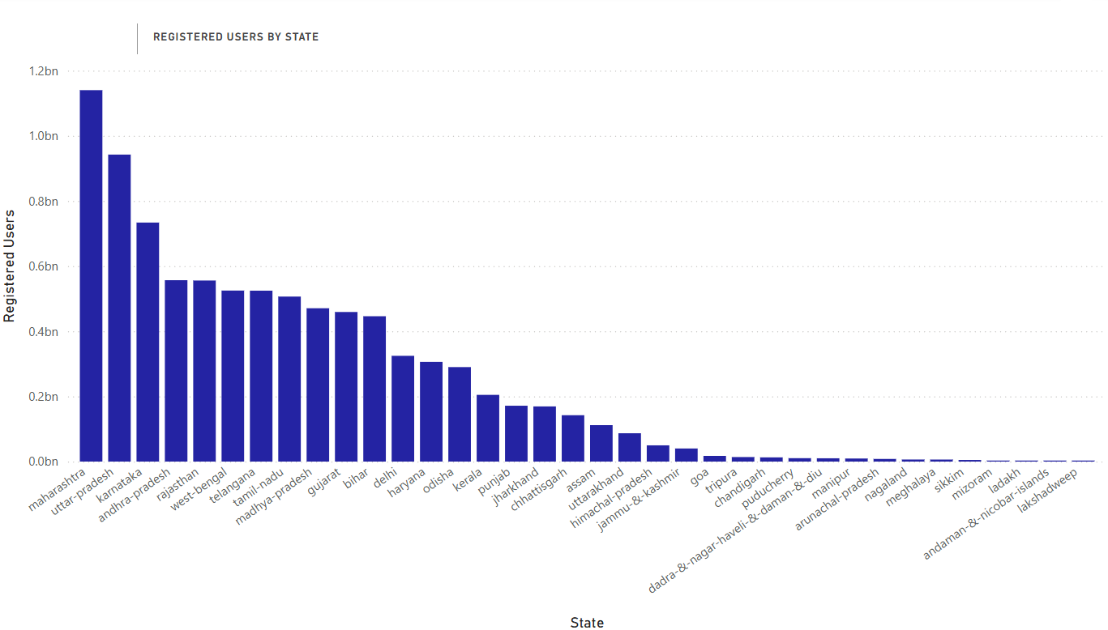
User Registered Users Distribution by States
Key Findings
Maharashtra has the highest number of registered users, followed by Uttar Pradesh and Karnataka.
States like Andhra Pradesh, Karnataka, Telangana, and Tamil Nadu show strong adoption of Phonepe.
Northeastern states and union territories (e.g., Mizoram, Sikkim, Ladakh) show significantly fewer registered users, indicating lower outreach.
Recommendations
Run state-specific digital literacy programs and influencer-based promotions to boost adoption in low-user regions.
Partner with regional stakeholders for onboarding drives, cashback offers, or events promoting Phonepe usage.
Customize app experience with local languages and simpler UI for rural/under-digitalized areas to improve onboarding.

Slide 11
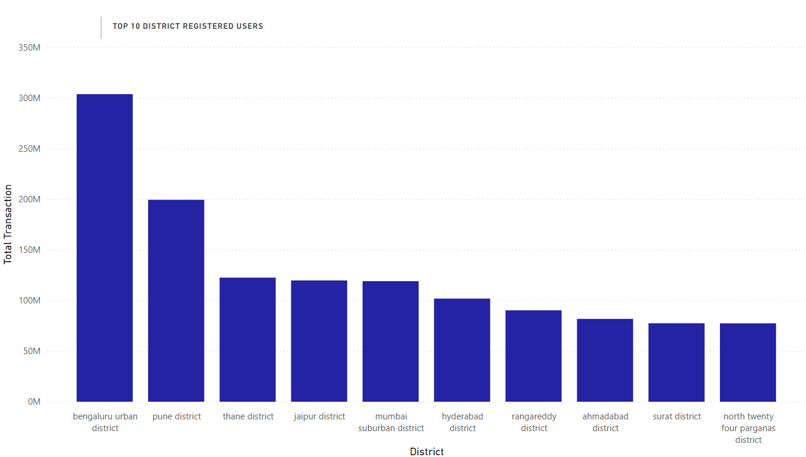
District User Penetration Analysis
Key Findings
Bengaluru Urban leads with the highest number of registered users, crossing 300M.
Pune, Thane, and Jaipur show strong adoption, indicating tech-savvy populations.
All top 10 districts are major urban centers, reflecting higher digital awareness and smartphone penetration.
Recommendations
Expand outreach in Tier-2 and Tier-3 districts by replicating strategies used in top-performing urban zones.
Partner with local businesses in mid-level districts to drive app adoption through merchant integrations.

Slide 12
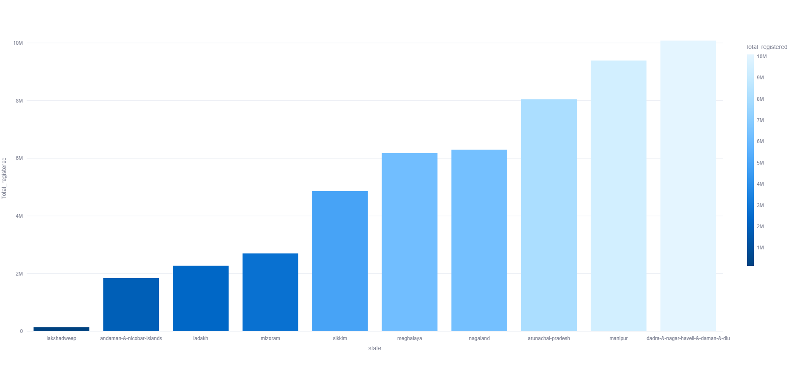
Lowest Registered User by states
Key Findings
Lakshadweep, andaman & nicobar, and ladakh show the lowest digital adoption in terms of registered users.
Smaller northeastern states like mizoram, sikkim, and meghalaya have limited penetration, though better than uts.
Despite decent infrastructure in places like dadra & nagar haveli & daman & diu, user growth is still low.
Recommendations
Targeted Digital Literacy Campaigns in UTs and northeastern regions to increase awareness and adoption.
Incentivize Onboarding with promotional offers or cashbacks for first-time users in low-penetration areas.

Slide 13
Transaction analysis across states and district

Slide 14
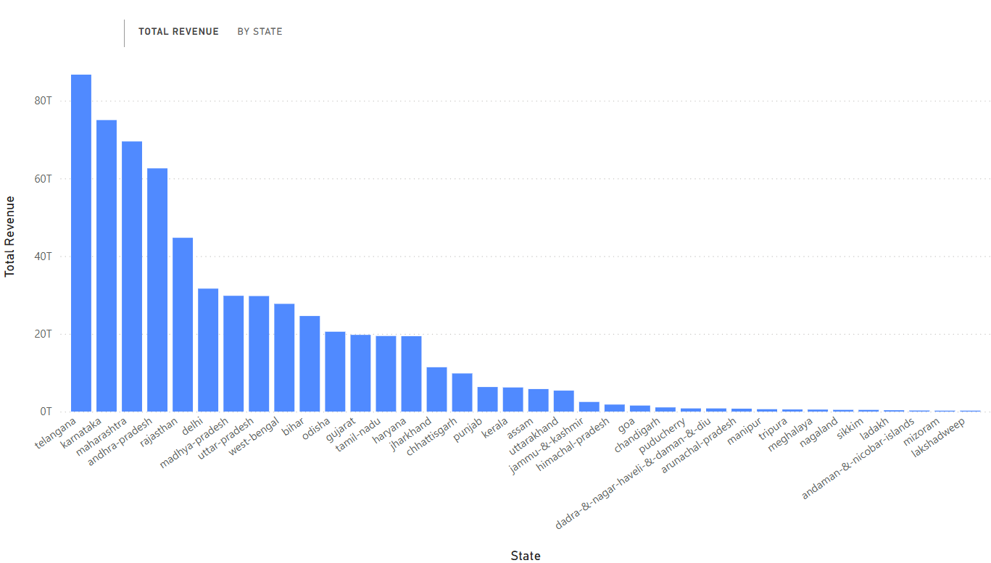
Total Revenue by States
Key Findings
Telangana, Karnataka, and Maharashtra lead in total revenue, indicating high digital transaction value.
Smaller and northeastern states like Mizoram, Sikkim, and Lakshadweep contribute minimally.
Recommendations
Analyze high-performing states' strategies to replicate success in low-revenue regions.
Encourage merchant adoption and bulk payments in underperforming states to boost value per user.

Slide 15
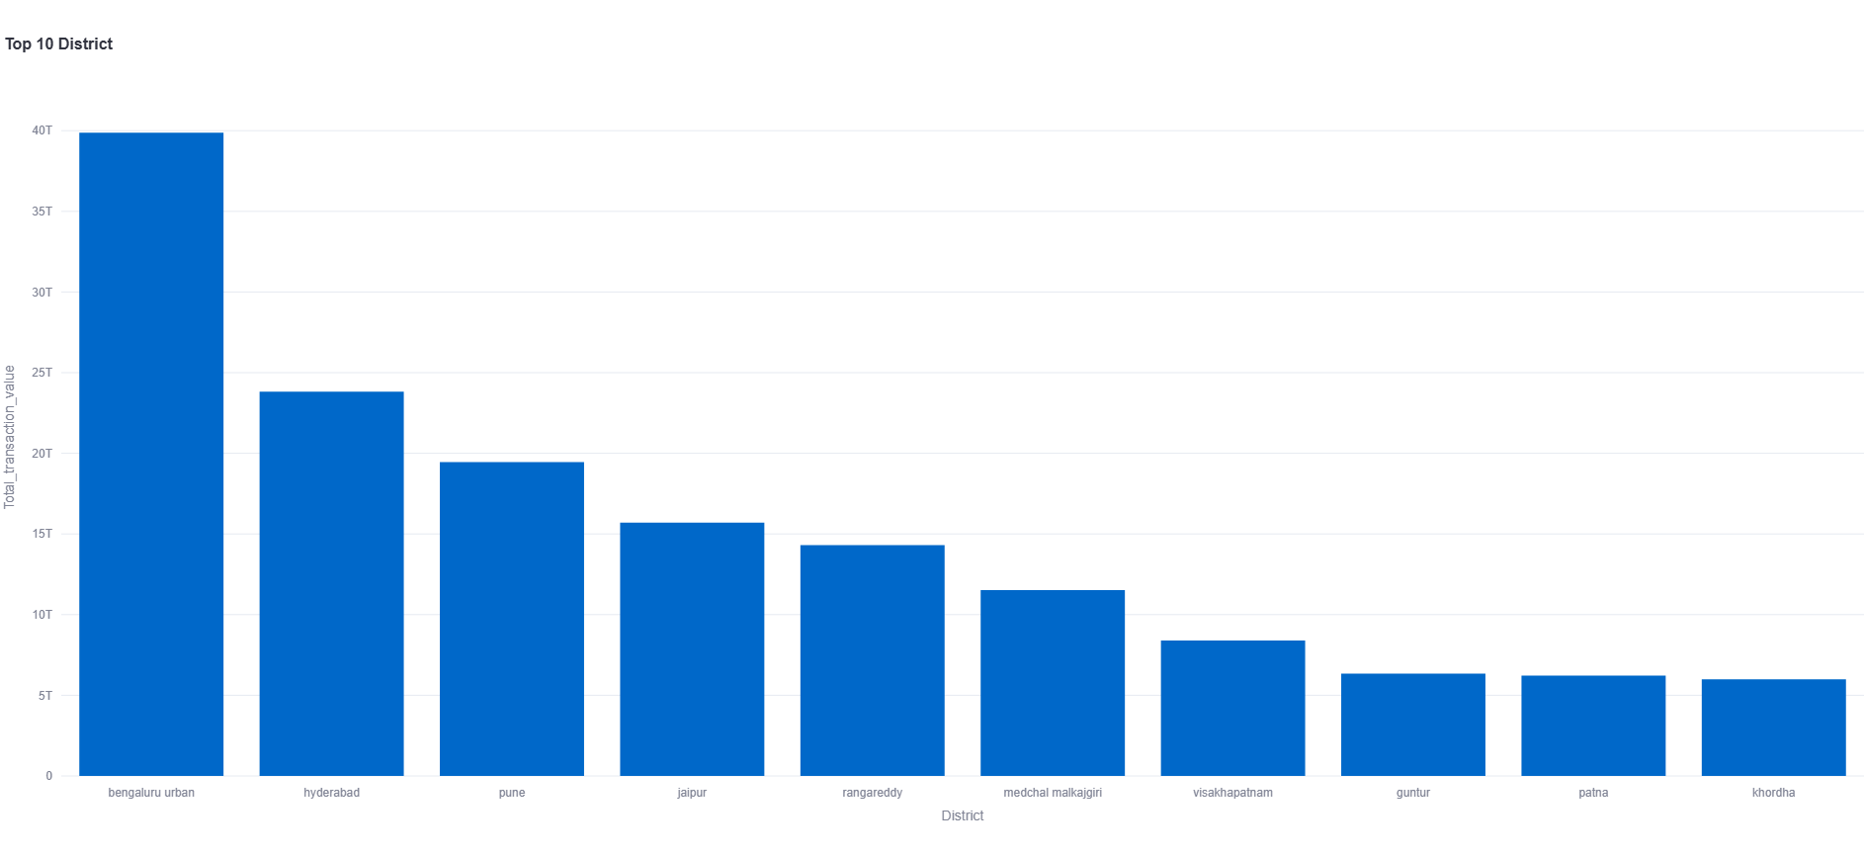
Top 10 District Total Transaction values
Key Findings
Bengaluru Urban dominates with the highest total transaction value among all districts.
Hyderabad and Pune follow as strong digital transaction hubs.
Districts from Andhra Pradesh and Telangana show strong digital transaction adoption.
Recommendations
Replicate Bengaluru’s engagement strategies in emerging metro districts to boost transaction value.
Invest in digital merchant onboarding and fintech literacy in tier-2 districts.

Slide 16
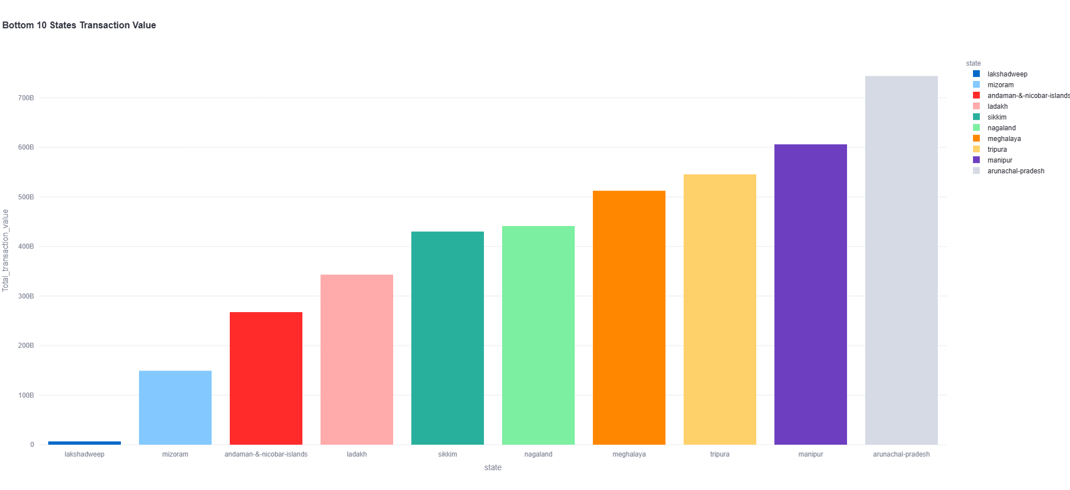
Bottom 10 States Transaction
Key Findings
Lakshadweep shows significantly lower transaction value compared to all other states listed.
Arunachal Pradesh consistently records the highest transaction value among the bottom 10 states.
There's a gradual increase in transaction value from Mizoram up to Arunachal Pradesh, with no drastic drops.
Recommendations
Investigate factors hindering transaction value in Lakshadweep to identify potential growth opportunities.
Analyze Arunachal Pradesh's transaction patterns to identify best practices applicable to other lower-performing states.

Slide 17
User Registration analysis

Slide 18
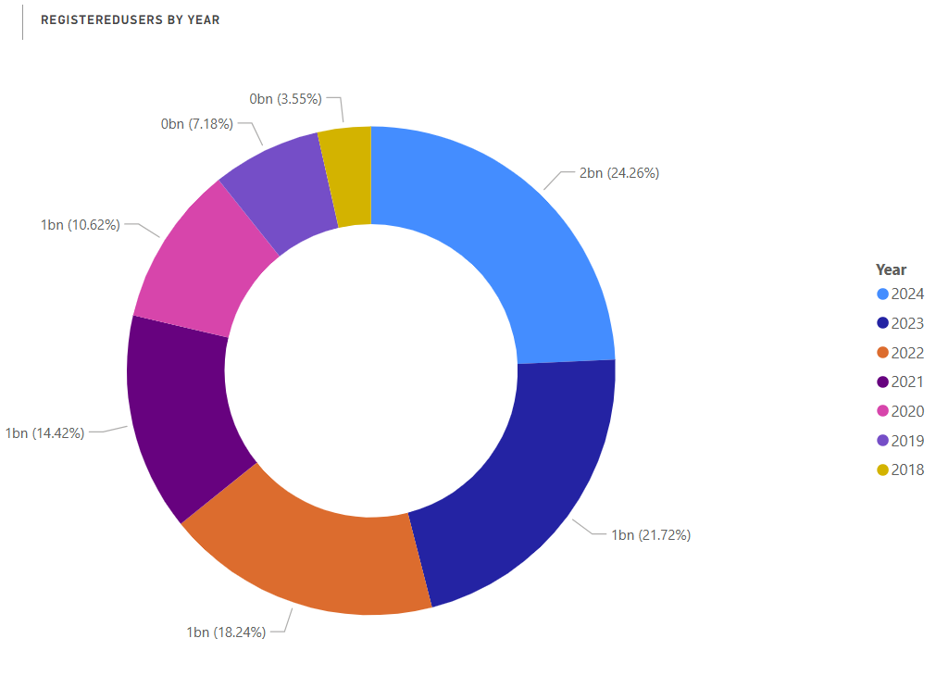
Registered Users Over Years
Key Findings
The largest share of registered users (24.26%) was acquired in 2024, indicating strong recent growth.
The years 2021, 2020, and 2019 collectively account for a significant portion, each contributing over 10% of total registered users.
Recommendations
Analyze the strategies from 2024 to understand and replicate drivers of high user registration.
Develop targeted re-engagement campaigns for users registered in earlier years (e.g., 2018, 2019) to boost activity.

Slide 19
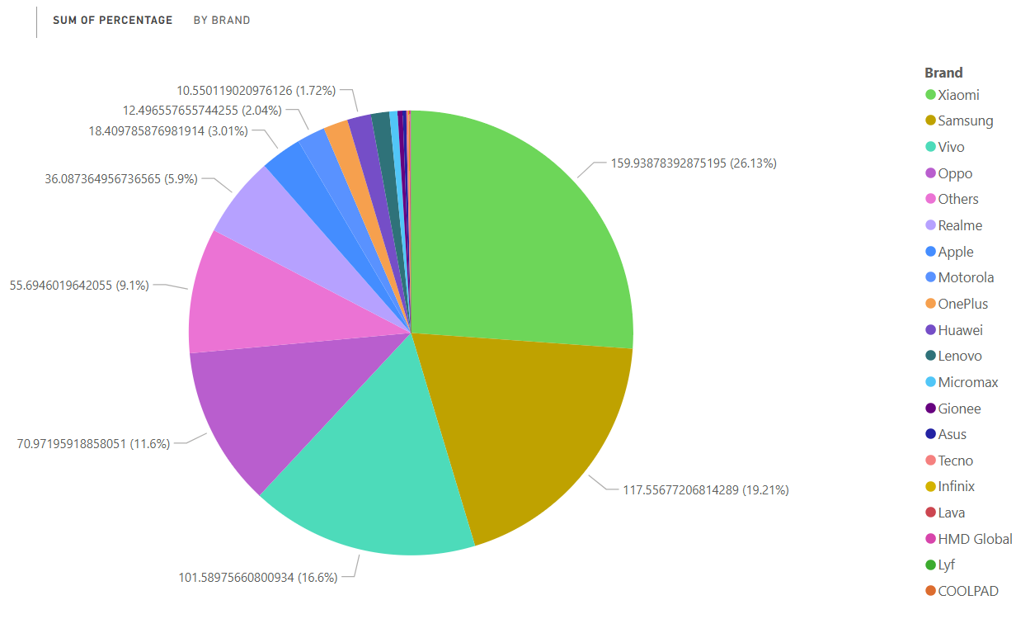
Percentage of Registered Users by Brand
Key Findings
Xiaomi, Samsung, Vivo, and Oppo dominate app usage among registered users, forming the top tier of mobile brands.
Apple, Realme, Motorola, and OnePlus represent a significant "next tier," showing moderate but consistent app engagement.
Lava, HMD Global, LYF, and Coolpad show the lowest app usage among registered users, indicating minimal market penetration or engagement in this segment.
Recommendations
Prioritize optimization and feature development for Xiaomi, Samsung, Vivo, and Oppo users to capitalize on their large market share.
Develop targeted growth and retention strategies for the "next tier" brands (Apple, Realme, etc.) to convert their users into more active app users.

Slide 20
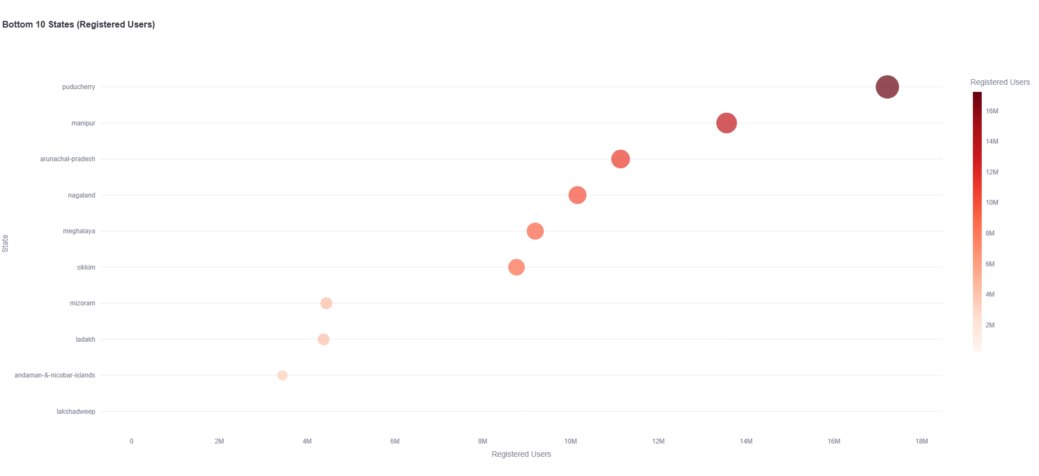
Bottom 10 States Registered Users
Key Findings
Puducherry has the highest number of registered users among the bottom 10 states, significantly outperforming others.
Lakshadweep, Andaman & Nicobar Islands, and Ladakh consistently show the lowest number of registered users.
Recommendations
Analyze Puducherry's user registration strategies to identify best practices for increasing user base in other states.
Develop targeted user acquisition campaigns for states with very low registered users like Lakshadweep and Andaman & Nicobar Islands.

Slide 21
Insurance transaction analysis

Slide 22
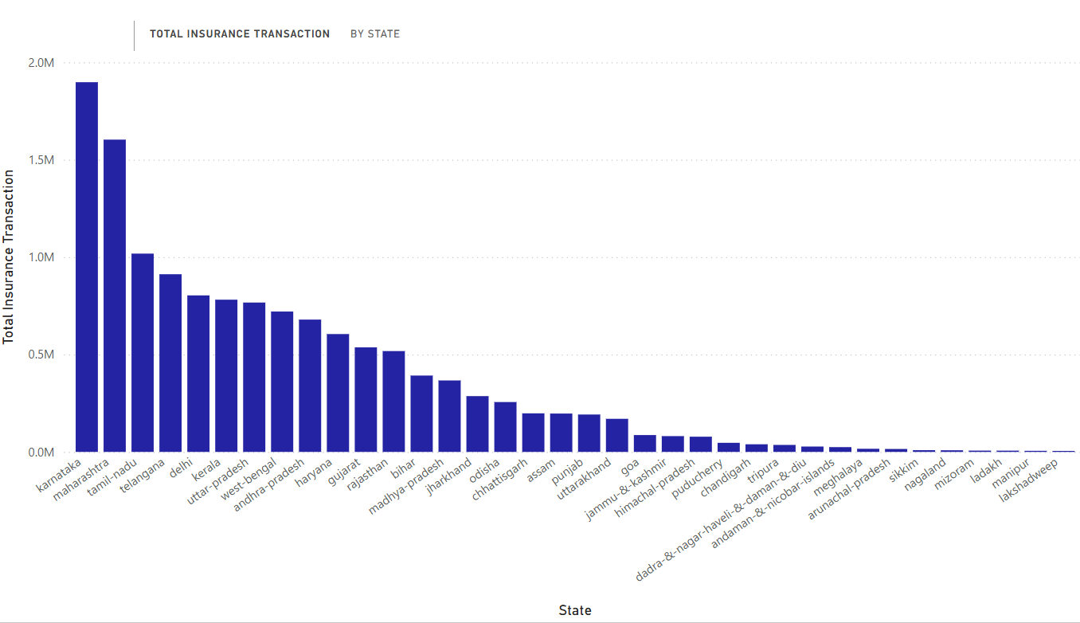
Total Insurance Transaction by states
Key Findings
Karnataka and Maharashtra significantly dominate total insurance transactions, far exceeding all other states.
There's a steep drop-off in transaction volume after the top few states, with many states showing very low insurance activity.
North Eastern states and Union Territories like Lakshadweep, Mizoram, Sikkim, and Nagaland record negligible insurance transactions.
Recommendations
Analyze the success factors in Karnataka and Maharashtra to identify best practices for increasing insurance penetration in other states.
Develop targeted awareness and accessibility campaigns for states with low transaction volumes to boost insurance adoption.

Slide 23
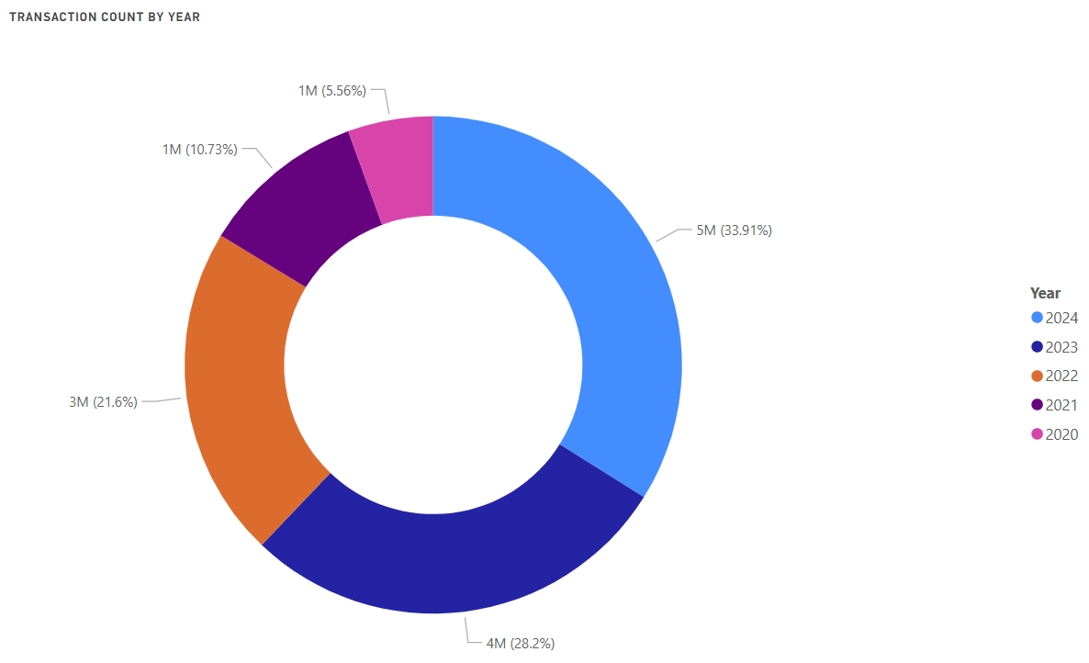
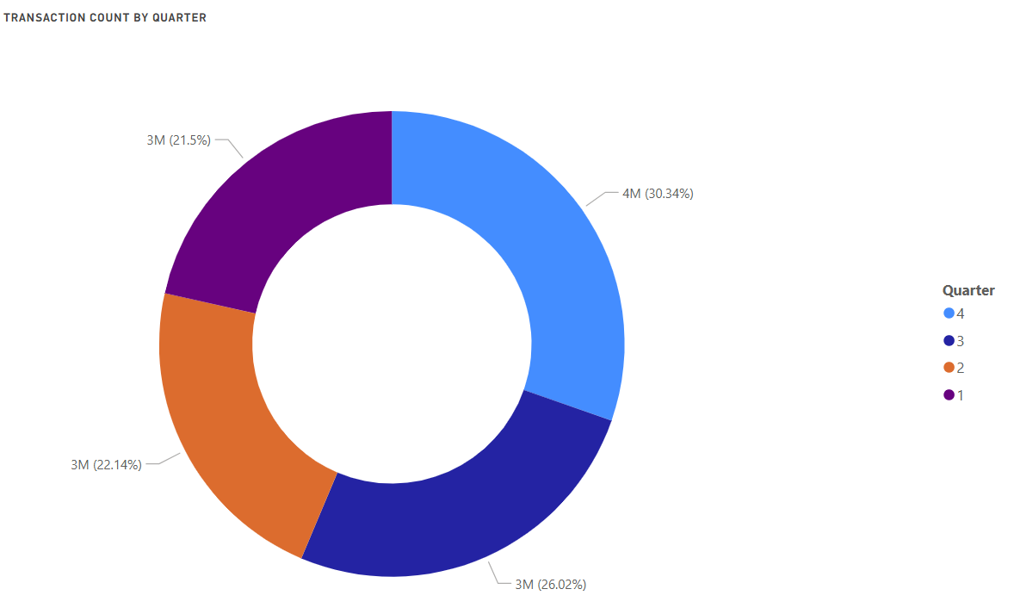
Yearly and Quarterly Breakdown
Key Findings
The year 2024 accounts for the largest share of transactions (33.91%), indicating a significant recent increase in activity.
The combined transactions from 2023 and 2022 represent over half of the total, showing strong cumulative growth in recent years.
Quarter 4 has the highest transaction count, representing over 30% of the total, indicating a peak in activity towards the end of the year.
Recommendations
Analyze the drivers behind the surge in transactions in 2024 to sustain and replicate this growth.
Leverage insights from Quarter 4's strong performance to develop strategies for boosting transaction counts in other quarters.
Implement targeted campaigns or incentives in Quarter 1 to stimulate transaction activity early in the year.

Slide 24
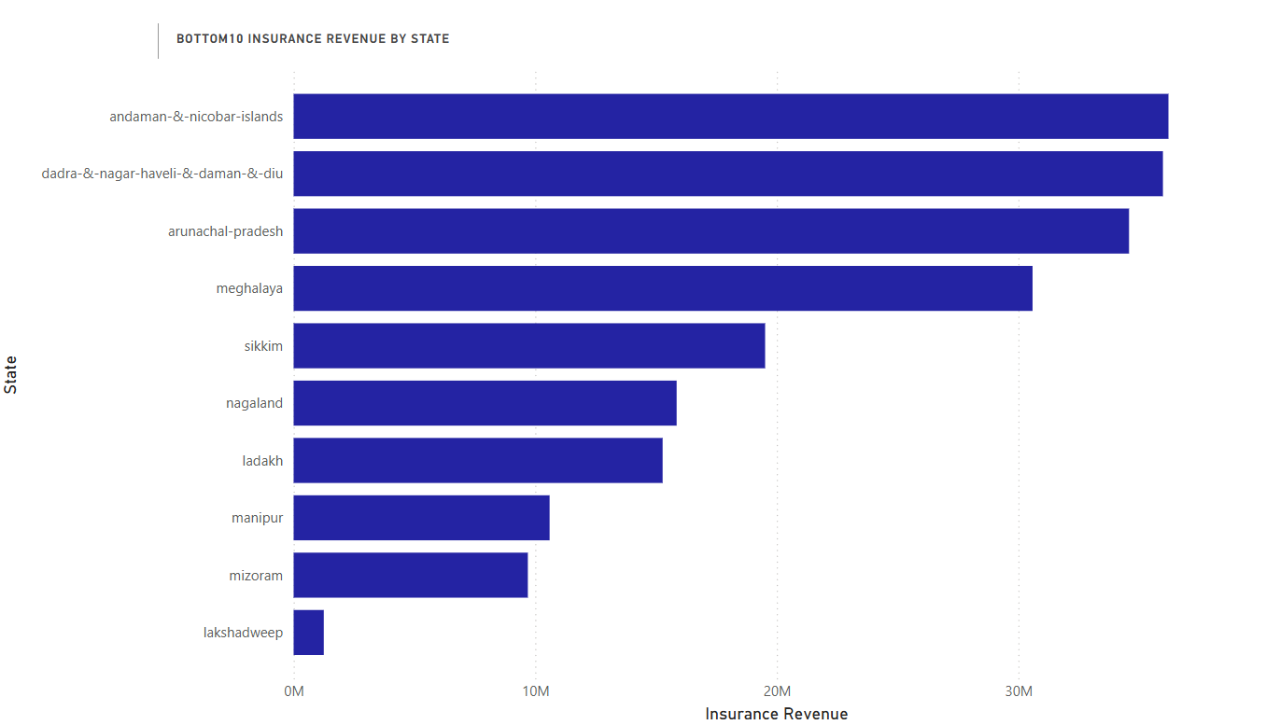
Bottom 10 Insurance Revenue by States
Key Findings
Andaman & Nicobar Islands and Dadra & Nagar Haveli & Daman & Diu lead the bottom 10 with the highest insurance revenue, both exceeding 35M.
Lakshadweep exhibits a significantly lower insurance revenue compared to all other states in the bottom 10, hovering around 2M.
Recommendations
Analyze the drivers behind the relatively higher insurance revenue in Andaman & Nicobar and Dadra & Nagar Haveli to identify transferable best practices.
Prioritize targeted interventions and awareness campaigns in Lakshadweep to address its exceptionally low insurance revenue.
Develop specific growth strategies for mid-range states like Sikkim, Nagaland, and Ladakh to help them improve their insurance revenue performance.

Slide 25
THANK YOU
Rajarajan N
rajarajann30@gmail.com

